Slide 1


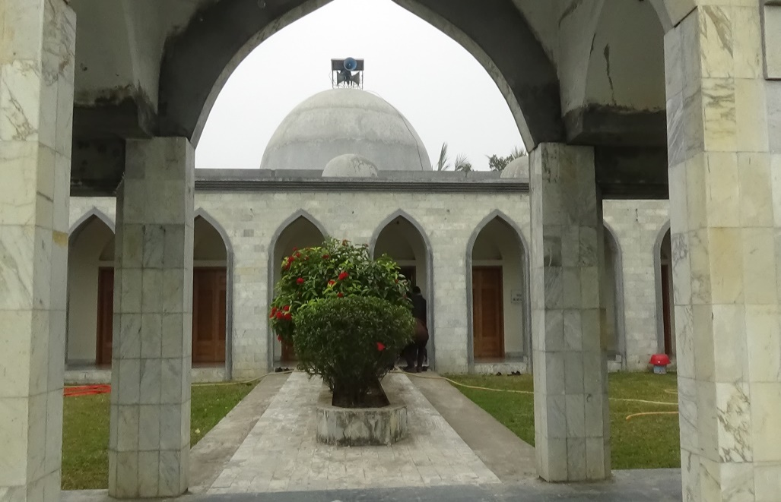
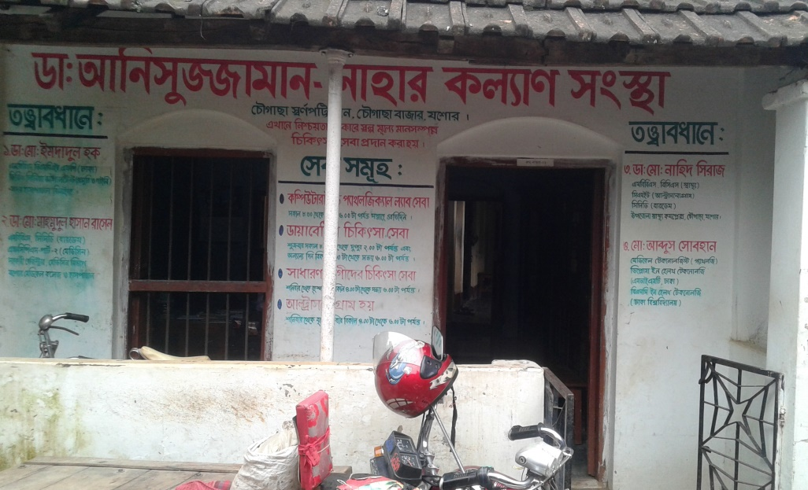
Development of Chowgacha Upazilla by Divine Group

Slide 2

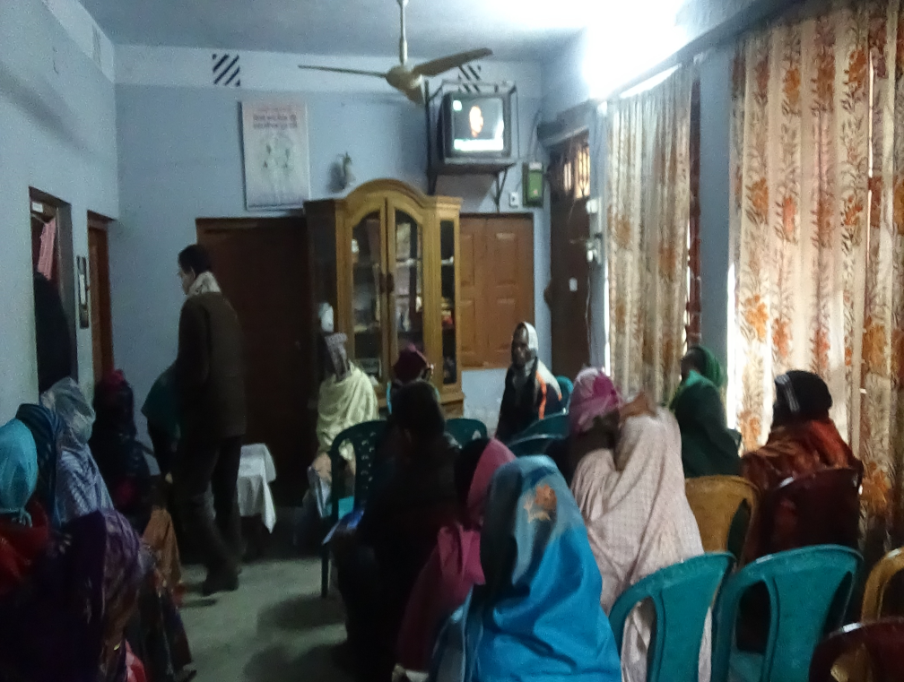
Dr. Anisuzzaman Nahar Kolyan Sangstha for poor and Diabetic patients.
Nearly 3 thousands Diabetic Patients is getting services from the centre.

Slide 3
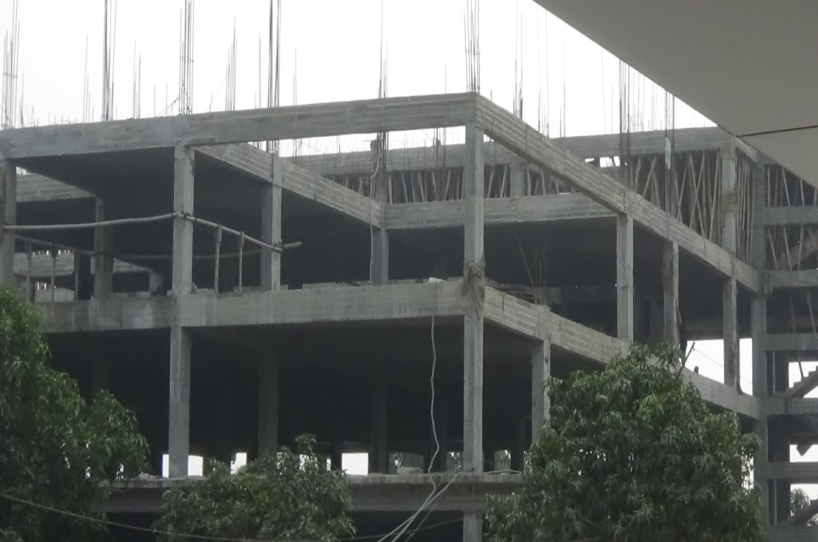
PHC Building front view
Secondary Hospital Under construction

Slide 4
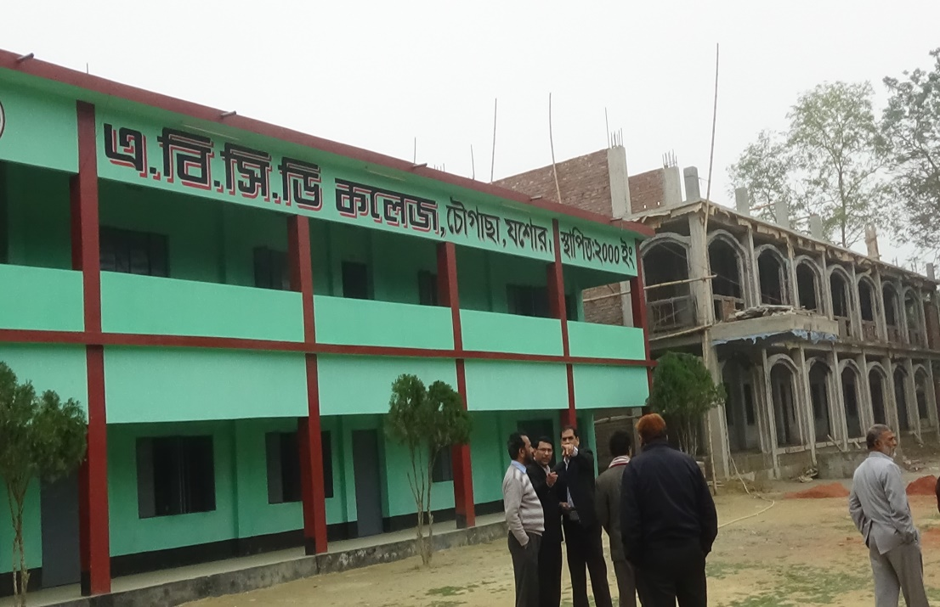
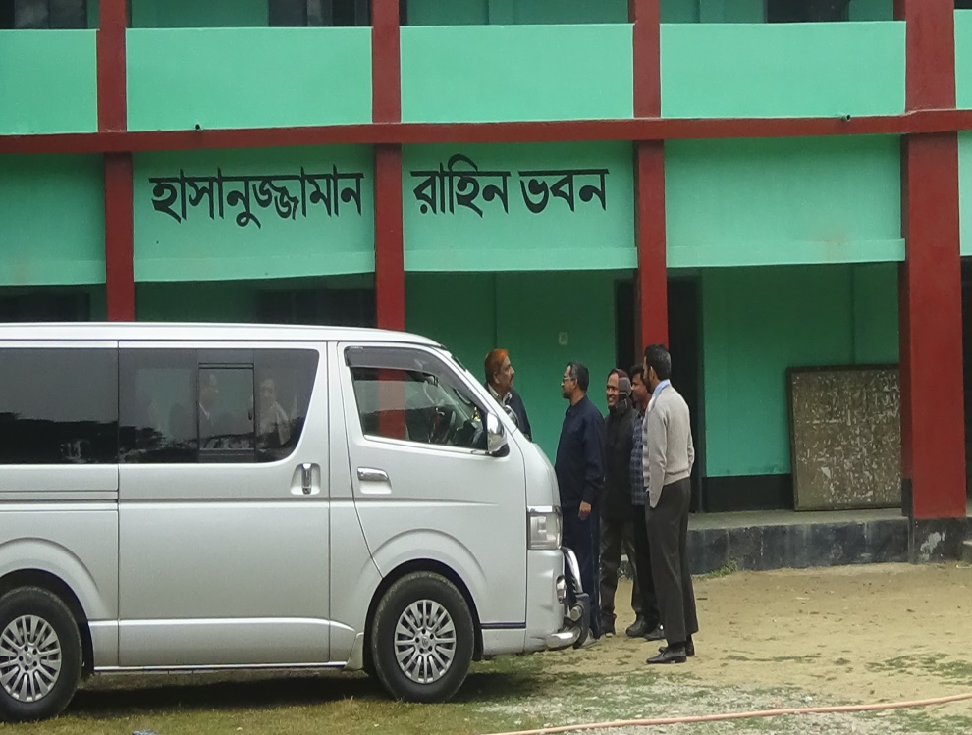
ABCD College is a Union level college having 3 Hons. Subject. The College has got a large grant from Devine Group.
Devine group supports 28 colleges, schools, madrasas and 110 primary schools for educational development

Slide 5
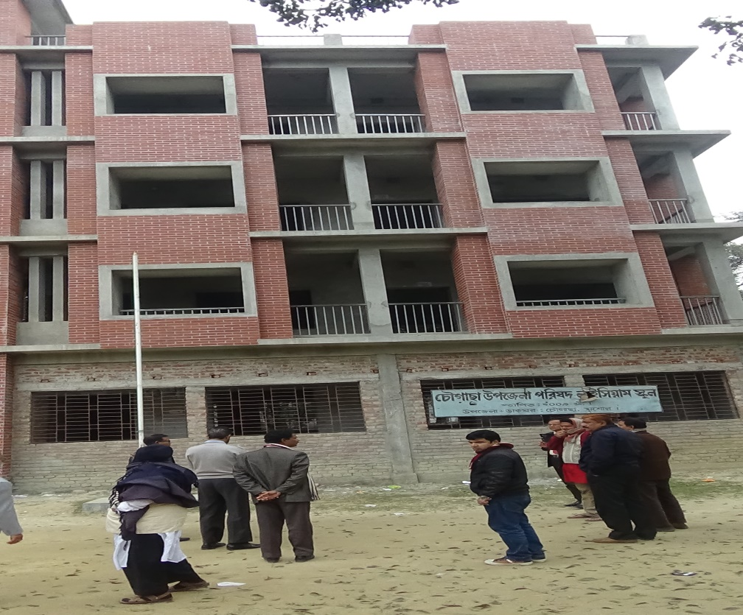
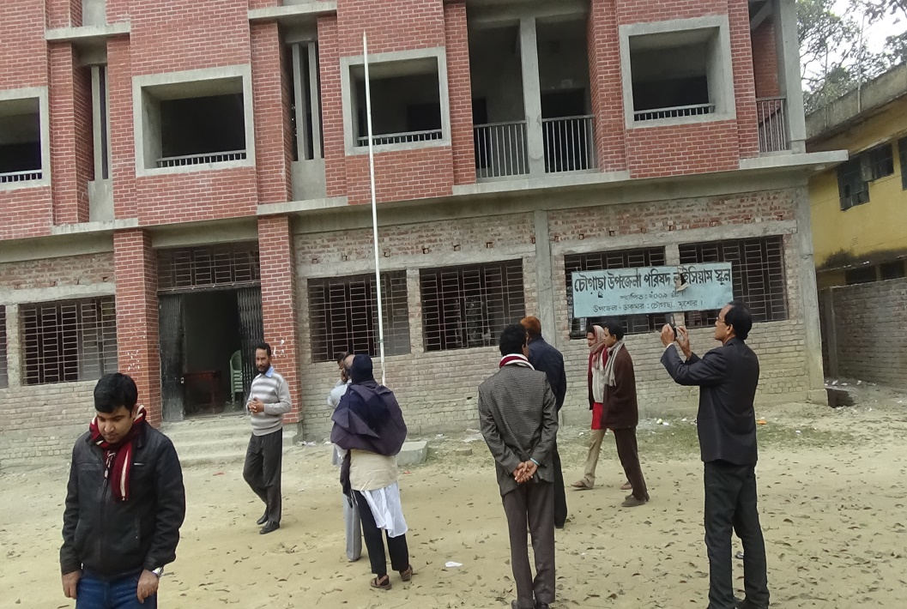
Chowgacha Upazilla Parishad Lyceum School (Primary – Class VIII) for the brilliant students of the Upazilla and for the officers’ children, supported by Devine group

Slide 6

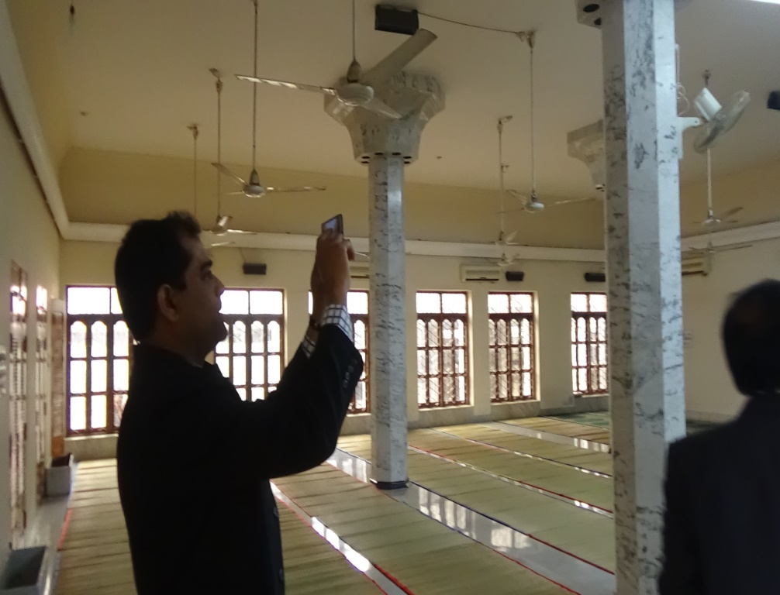
The Mosque of Devine Group
Internal View

Slide 7
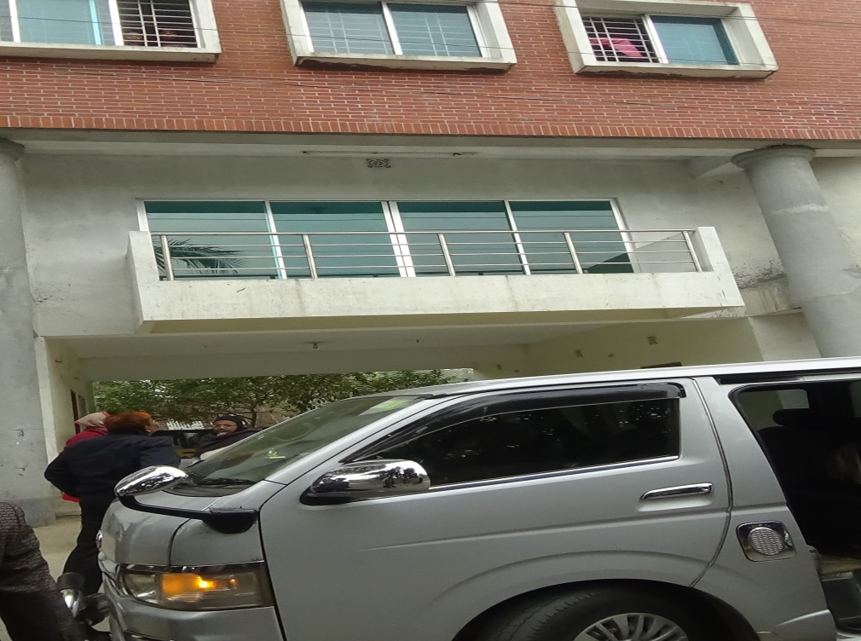
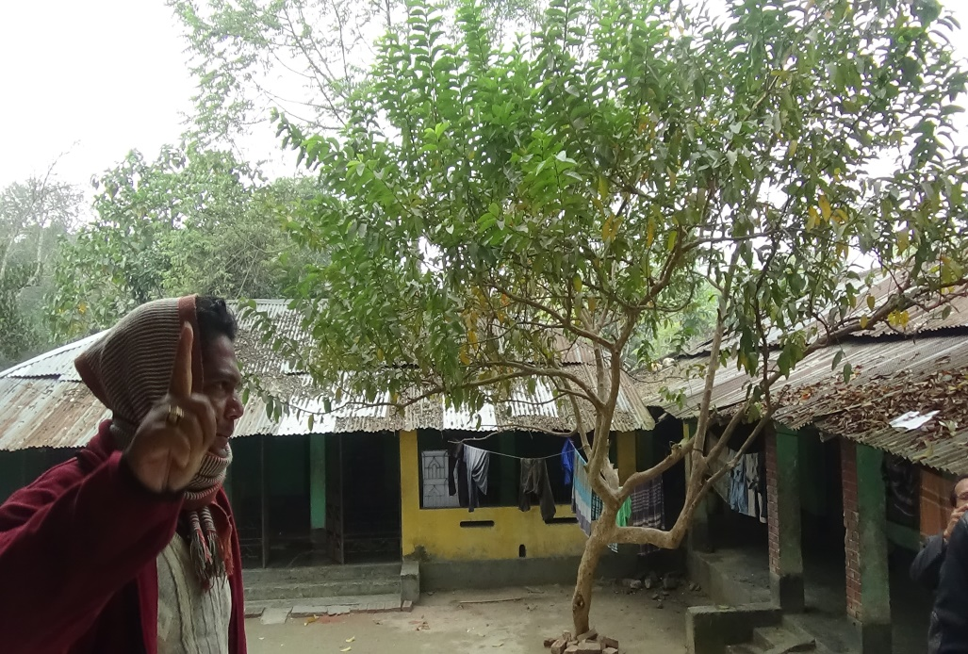
Orphanage Centre supported by Devine Group in Chowgacha.

Slide 8

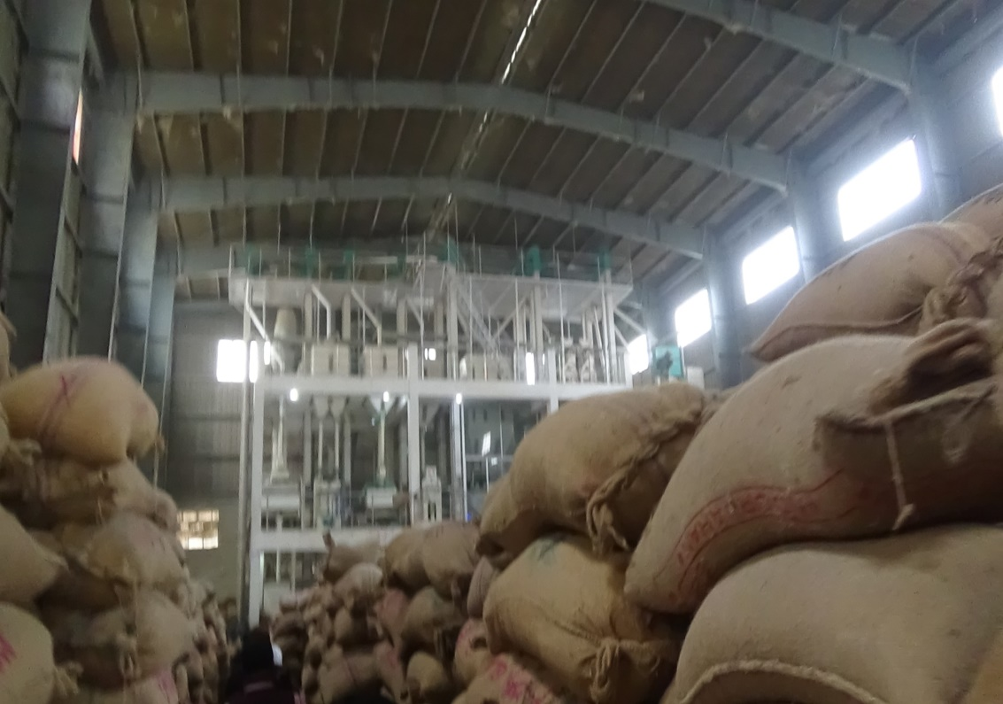
A large cold storage for Potato made by Devine group.
A rice cleaning and refine center of Devine group.

Slide 9
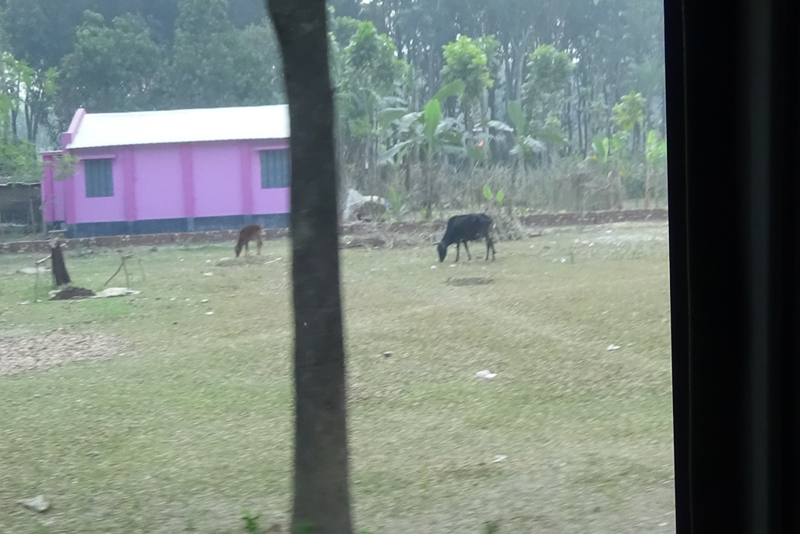
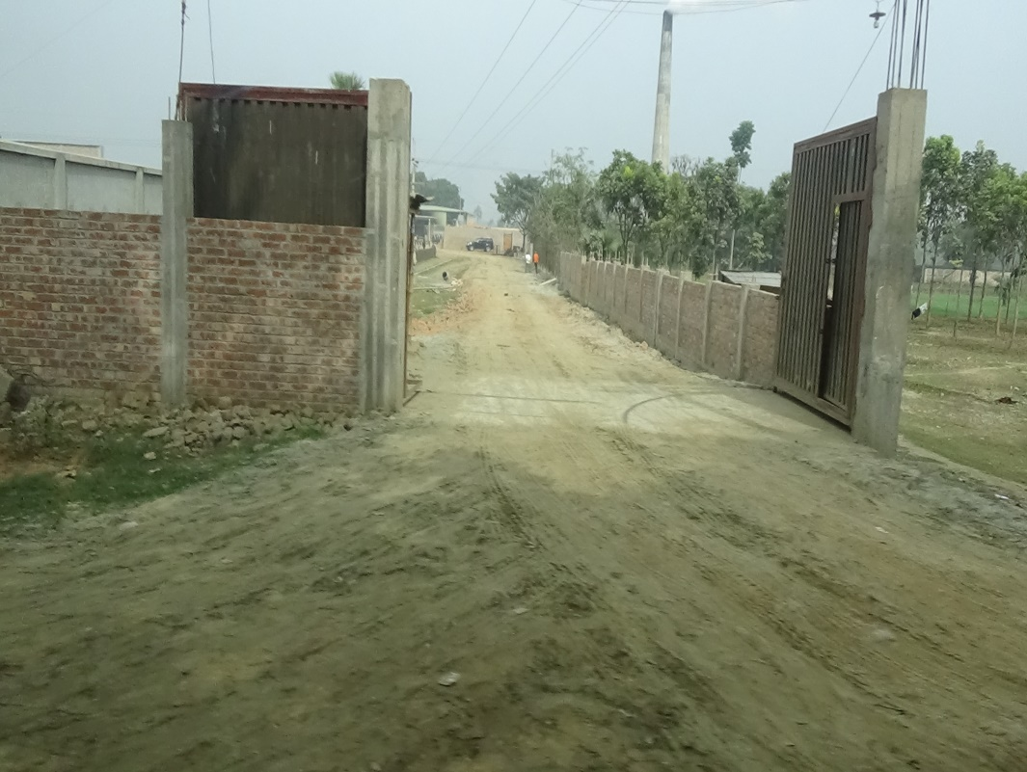
Housing service for the poor supported by Devine group. Nearly 500 house supported by the group and each costs 3 lac and 20 thousands taka.
A modern brickfield is made by the associates of Devine Group.

Slide 10

Thank You

